Slide 1
Task 7: Comparing Scheduling Algorithms
Jana Saleh 900204192
Muhammad Azzazy 900202821
Mariam Dahab 900192441

Slide 2
TABLE OF CONTENTS
01
02
03
04
Roles
Pseudocode
Role of every team member
Pseudocode of algorithms
Process Attributes
Testing
Process attributes chosen
How the algorithms were tested

Slide 3
TABLE OF CONTENTS
05
06
07
Smoothing
Results
How the curves were smoothed
Main results and conclusions
Bonus
Addressing mistakes and comments

Slide 4
Assumptions
For all three scheduling algorithms, the arrival times of processes are in increasing order.
For all three scheduling algorithms, the optimization criteria were assumed to be integers and the result of division was rounded down (integer division).
For MLFQ, the time quantum of the first two RR scheduling algorithms were fixed to 8 and 16, respectively.
For MLFQ, there was no aging mechanism implemented. This means that once processes reach FCFS, they never go back to a higher priority queue. In other words, processes which exceed the time quanta of both RR queues exit the algorithm from the tail of the FCFS queue.
For MLFQ, only a single process can exist in a queue during a certain time interval. This simulates single-core execution for simplicity.

Slide 5
01
Roles
Role of every team member

Slide 6
Name | Role
Jana Saleh | Implemented and tested First Come First Serve(FCFS)
Mariam Dahab | Implemented and tested Round Robin (RR) Created the Graphs
Muhammad Azzazy | Implemented and tested Multilevel Feedback Queue (MLFQ)

Slide 7
02
Pseudocode
Pseudocode of algorithms

Slide 8
FCFS
for v← 0 to nproc {
total_waiting_time += p[v].waitT;
total_turnaround_time += p[v].turnAroundT;
totalrespt += p[v].responseT }
avgwaitT ←total_waiting_time / nproc
avgturnT ←total_turnaround_time / nproc
avgrespt ←totalrespt / nproc
void FCFS_Scheduling (struct process p[], int nproc) {
double total_turnaround_time = 0.0, total_waiting_time = 0.0, avgwaitT = 0.0, totalrespt = 0.0, avgrespt = 0.0, double sumburst = 0, int totalburst[n], double avgturnT = 0, p[0].waitT = 0,
p[0].responseT = 0
for m ← 0 to nproc {
p[m].turnAroundT ←p[m].burst + p[m].waitT }
for k ← 1 to nproc {
p[k].waitT ← p[k - 1].burst + p[k - 1].waitT }
for i ← 0 to nproc {
p[i].responseT ← p[i].waitT }

Slide 9
FCFS
int main() {
int n , x = 0
struct process p[1000]
printf("Enter the number of processes: ")
scanf("%d", &nproc)
while (x < 10) {
for l ← 0 to nproc {
p[l].burst ←0
}
for i ← 0 to nproc {
if (i ==0)
p[i].arrivalT ← 0
else
p[i].arrivalT ← p[i - 1].arrivalT + (rand() % n) + 1
p[i].pid ← i + 1
p[i].burst = (rand() % nproc) + 1
}
FCFS_Scheduling(p , nproc)
x++
}

Slide 10
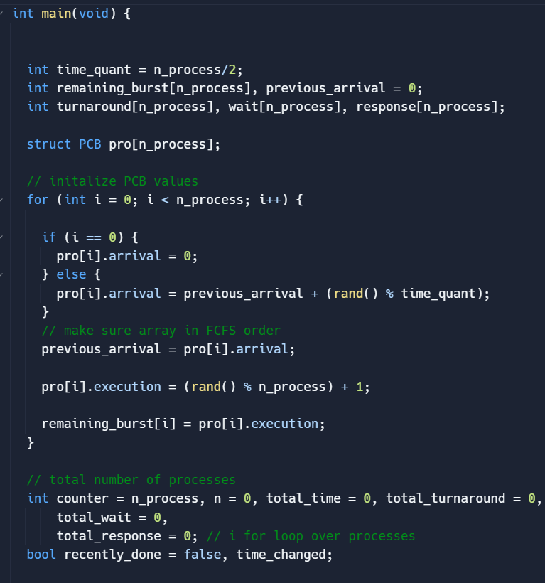
Round Robin
1- Initialize PCB

Slide 11
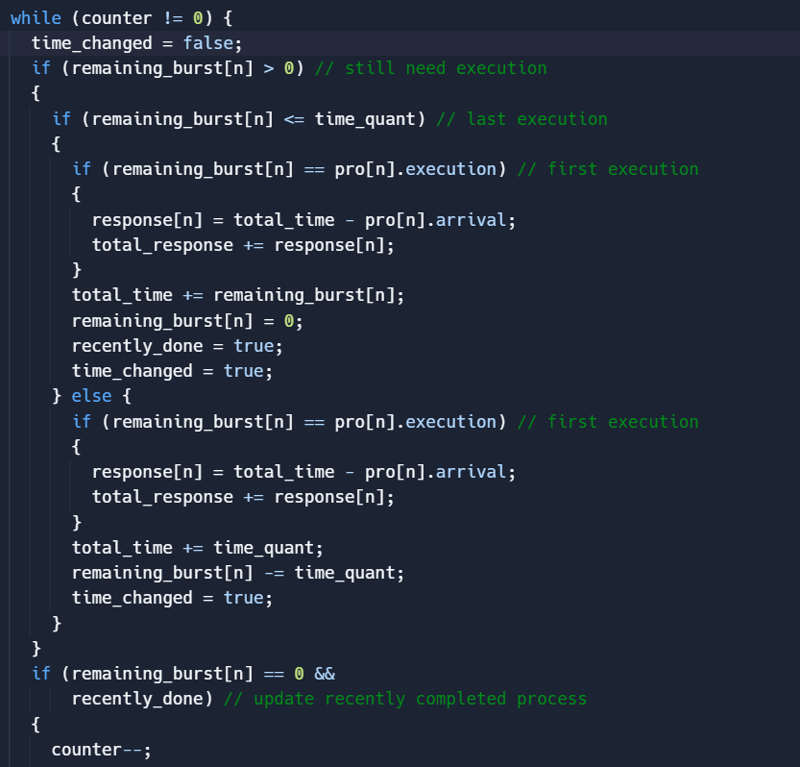
Round Robin
2- Execute

Slide 12
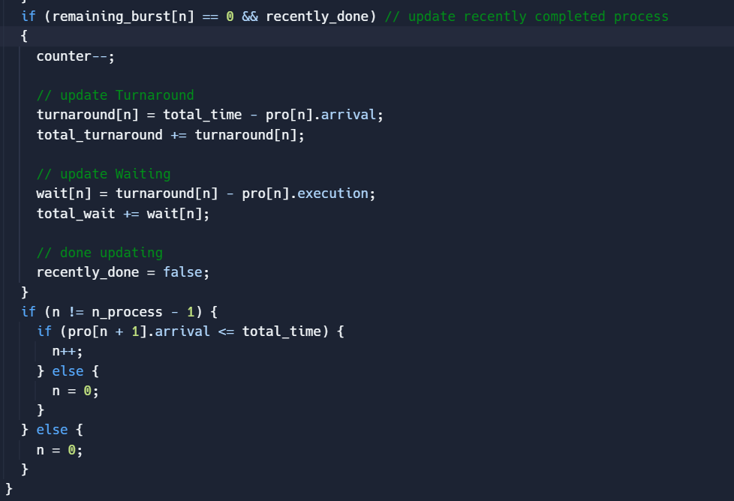
Round Robin
3- Update time and select next process

Slide 13
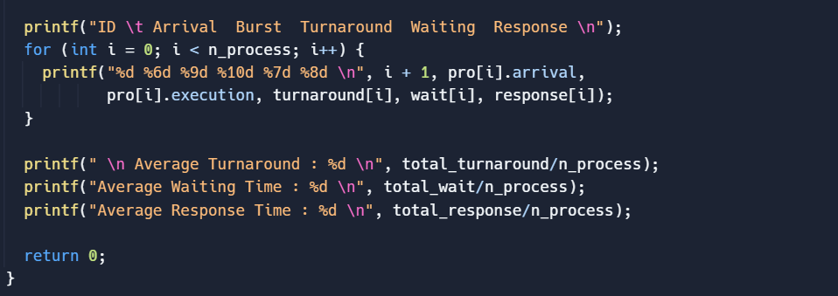
Round Robin
4- Print Scheduling Table and Average Time

Slide 14
MLFQ
MLFQ(n_proc, Process* processes)
quanta[0] ← 8
quanta[1] ← 16
total_waiting_time ← 0
total_time ← 0
total_turnaround_time ← 0
total_response_time ← 0
for i ← 1 to n_proc // initialize burst time of procs
do remaining_burst[i] ← processes[i].burst_time
for i ←1 to n // Q0 RR
do If remaining_burst[i] > 0
then if remaining_burst[i] == processes[i].burst_time // calculation of response time for proc
then response_time[i] ← total_time - processes[i].arrival_time
total_response_time ← total_response_time + response_time[i]

Slide 15
MLFQ
If remaining_burst[i] <= quanta[0] // if the process finishes from Q0 RR without preemption
then total_time ← remaining_burst[i]
remaining_burst[i] ← 0
turnaround_time[i] ← total_time - processes[i].arrival_time
total_turnaround_time ← total_turnaround_time + turnaround_time[i]
waiting_time[i] ← turnaround_time[i] - processes[i].burst_time
total_waiting_time ← total_waiting_time + waiting_time[i]
else // if the process exits Q0 RR with preemption
total_time ← total_time + quanta[0]
remaining_burst[i] ← remaining_burst[i] - quanta[0]
for i←1 to n_proc
do If remaining_burst[i] > 0
then if remaining_burst[i] <= quanta[1] // if the process finishes from Q1 without preemption
then total_time ← total_time + remaining_burst[i]
remaining_burst[i] ← 0
turnaround_time[i] ← total_time - processes[i].arrival_time
total_turnaround_time ← total_turnaround_time + turnaround_time[i]
waiting_time[i] ← turnaround_time[i] - processes[i].burst_time
total_waiting_time ← total_waiting_time + waiting_time[i]

Slide 16
MLFQ
else // if the process exits from Q1 with preemption
total_time ← total_time + quanta[1]
remaining_burst[i] ← remaining_burst[i] - quanta[1]
for i ← 1 to n
do if remaining_burst[i] > 0 // if the process finishes from Q1 FCFS (non-preemptive)
then total_time ← total_time + remaining_burst[i]
remaining_burst[i] ← 0
turnaround_time[i] ← total_time - processes[i].arrival_time
total_turnaround_time ← total_turnaround_time + turnaround_time[i]
waiting_time[i] ← turnaround_time[i] - processes[i].burst_time
total_waiting_time ← total_waiting_time + waiting_time[i]
average_turnaround_time ←total_turnaround_time/n_proc
average_waiting_time ← total_waiting_time/n_proc
average_response_time ← total_response_time/n_proc
printf("Average turnaround time: %d\n", average_turnaround_time)
printf("Average waiting time: %d\n", average_waiting_time)
printf("Average response time: %d\n", average_response_time)

Slide 17
03
Process Attributes
Process attributes chosen

Slide 18
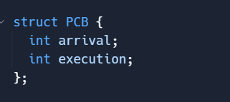
For all three scheduling algorithms , the only attributes needed from a process was its arrival time and burst (execution ) time .
These two values were used to determine which process to be executed next , for how long , and to calculate the three optimization criteria for each process

Slide 19
04
Testing
How each algorithm was tested

Slide 20
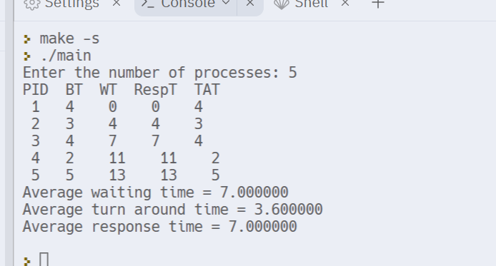
FCFS
The program asks the user for the number of process then random numbers are generated for the burst time and arrival time for each process and then their response , waiting and turnaround time were calculated
A process table is printed as shown printing all the required times for each process and then their averages is calculated at the end
This is a simple test on 5 processes to illustrate.

Slide 21
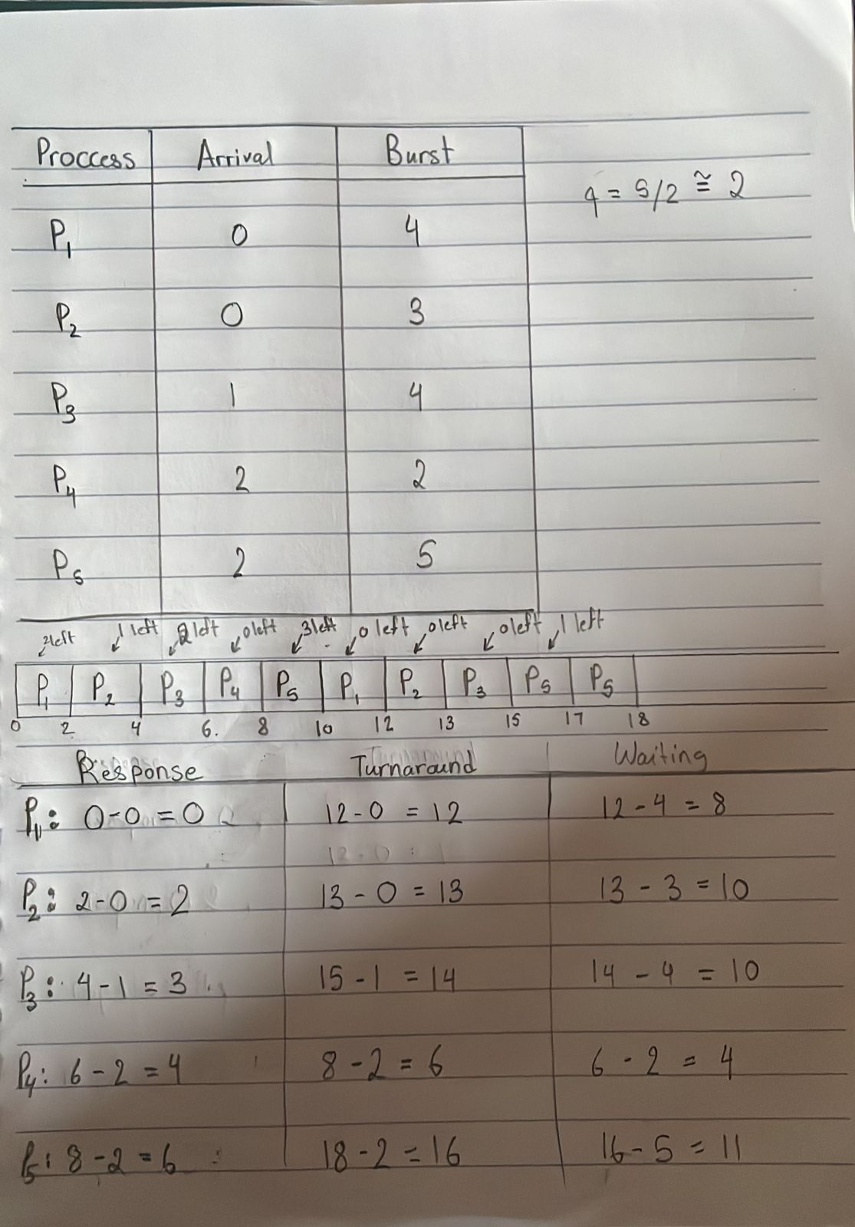
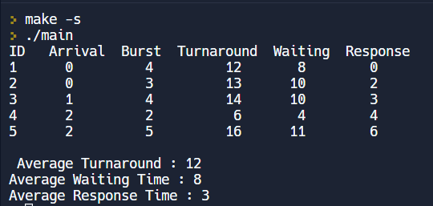
RR
The program automatically generated 5 process each given a random arrival time and burst time .
After going through the scheduling process a scheduling table was printing showing arrival , executing , turnaround , waiting , and response time.
To test , the same arrival and execution time where scheduled manually and the result was compared .

Slide 22
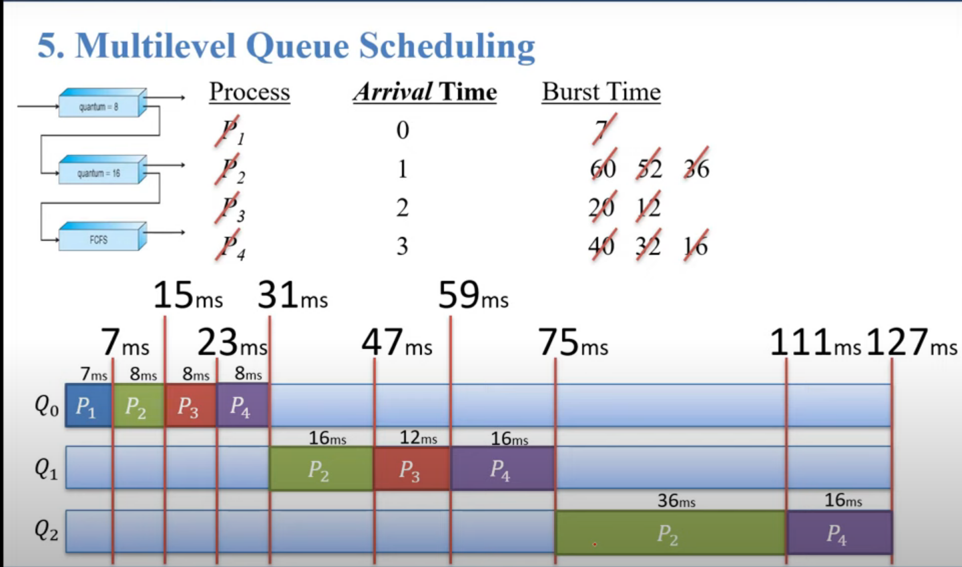
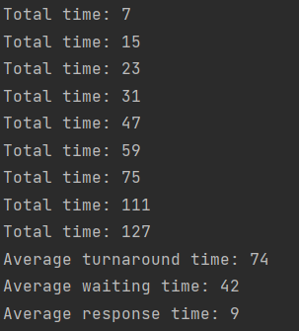
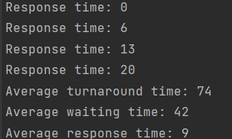
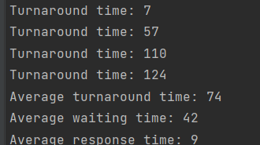
MLFQ
The test was done on 4 processes for simplicity.
Echoing the changes to some variables was done to ensure that the total time, turnaround time, waiting time, and response time are accurate.
https://www.youtube.com/watch?v=b9EYSLmG8QQ&list=PLxIvc-MGOs6ib0oK1z9C46DeKd9rRcSMY&index=13

Slide 23
05
Smoothing
By running each set of processes 10 times and taking the average . We were able to create a smooth curve for each line in the curve.

Slide 24
06
Conclusions
Main results and conclusions

Slide 25
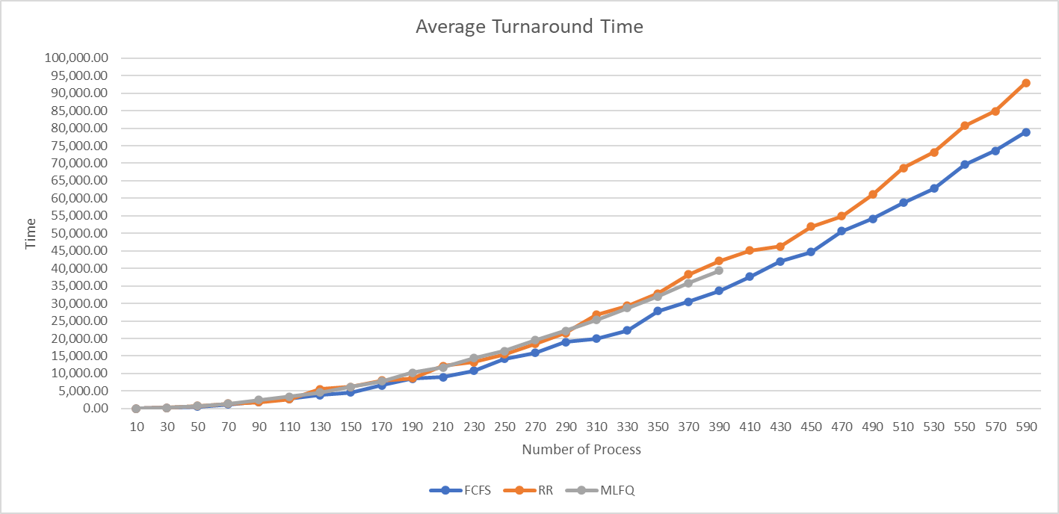
When comparing the scheduling algorithms using the average turnaround values , we could see that FCFS is the optimal choice as the number of process increase

Slide 26
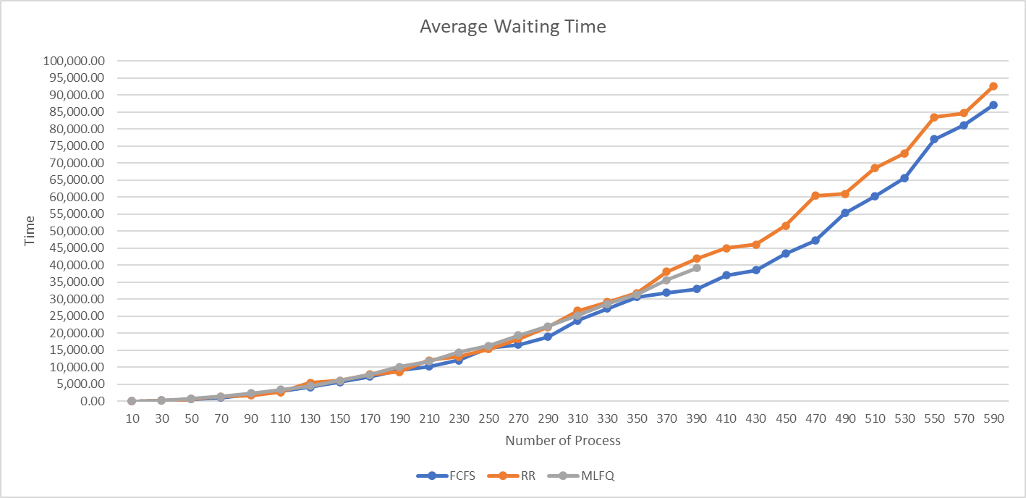
Again , difference in performance can be noticed with large process number .
The winner is clearly the FCFS as it shows a lower average waiting time for large number of processes

Slide 27
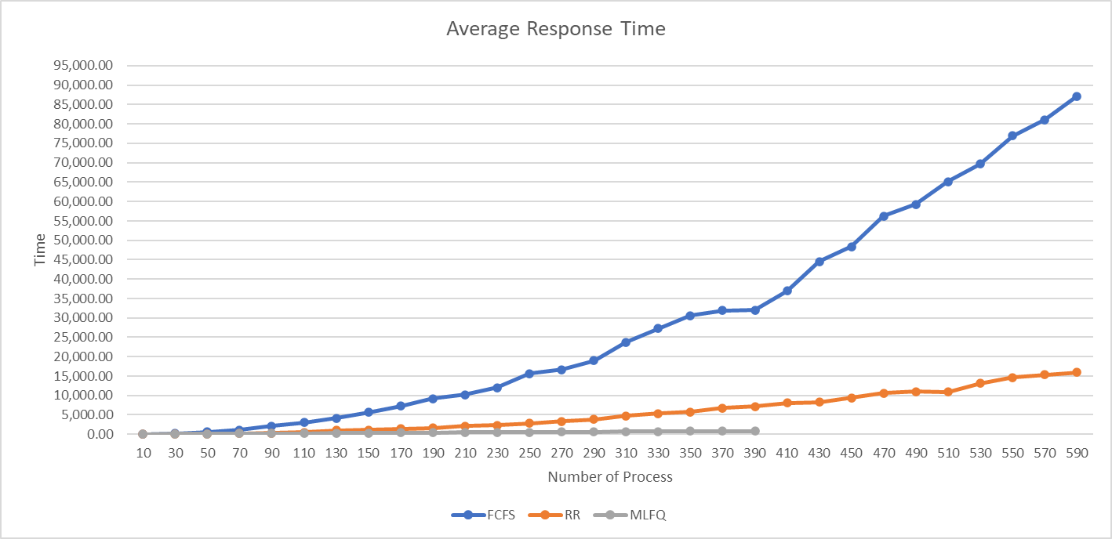
In case of response time, MLFQ hard the optimal performance and FCFS should an exponential increase making it the worst performance

Slide 28
07
Bonus
Addressing mistakes and comments

Slide 29
Bonus
A lower value for priority of a process means higher priority.
Submitted a version of xv6 where the default priority is set in the scheduler itself instead of the fork system call.

Slide 30
THANKS!
janasaleh@aucegypt.edu
mariamhdahab@aucegypt.edu
muhammad-azzazy@aucegypt.edu
Please keep this slide for attribution

